Slide 1
Passage of a nerve impulse
Year 11 Biology
Bremer SHS

Slide 2
Warm-up questions
Compare passive and active transport.
(Your answer should include the terms diffusion and ATP)
Contrast endocytosis and exocytosis.
Name the three types of neurons and outline their functions.
Explain why reflexes are processed by the spinal cord rather than the brain.
(Your answer should use the terms receptor and effector)
Outline the role of the circulatory system in maintaining homeostasis.

Slide 3
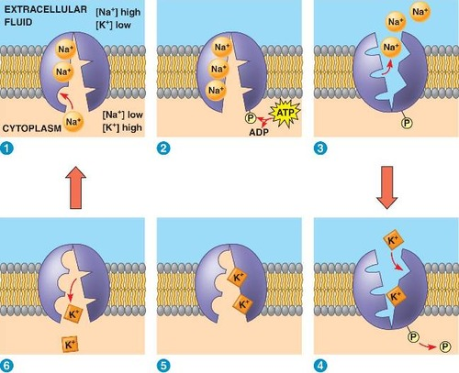
Sodium potassium pumps

Slide 4
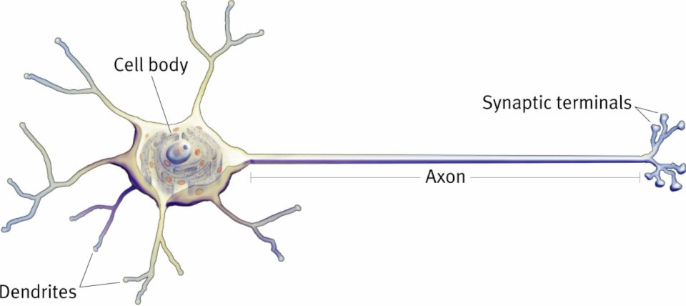
Passage of a nerve impulse
When an axon is not transmitting an impulse it is slightly positive on the inside and very positive on the outside.
External or internal stimuli can initiate a nerve impulse.
Stimulus detection by a receptor initiates a message by opening up ion channels in the cell membrane of the dendrites.
Open ion channels allowing ions to move across the cell membrane.
The influx of positive ions changes the net charge inside a neuron and starts a cascade of electrical activity down the axon.

Slide 5
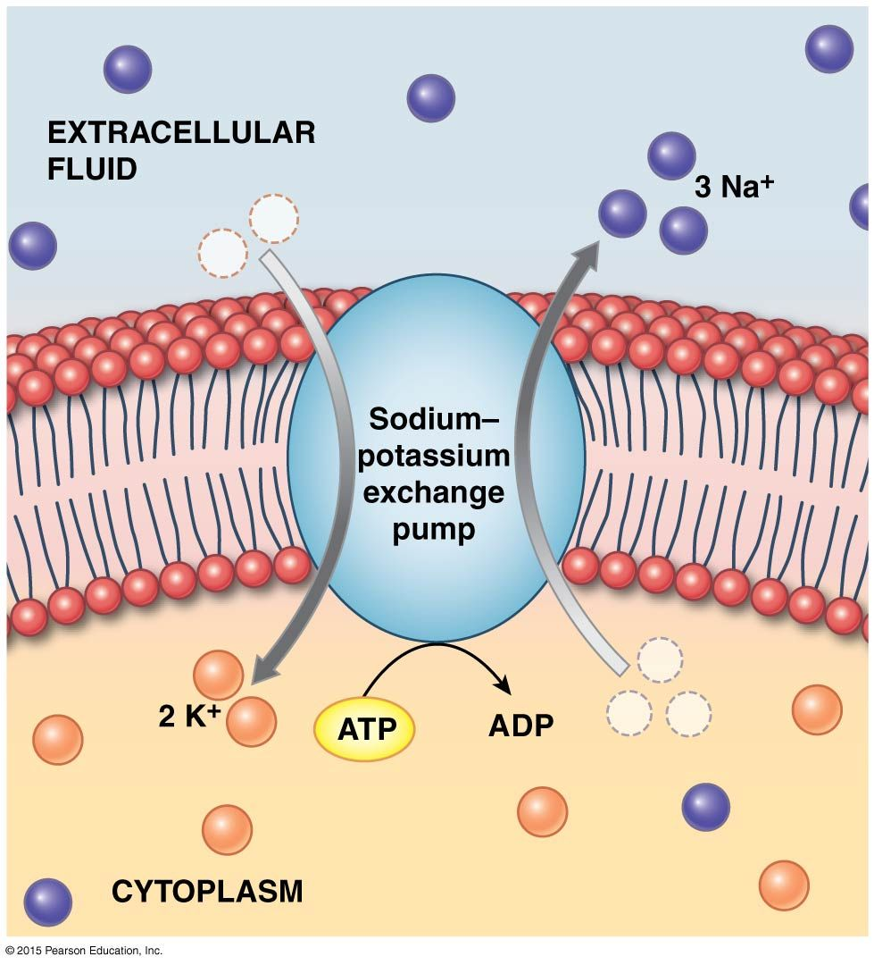
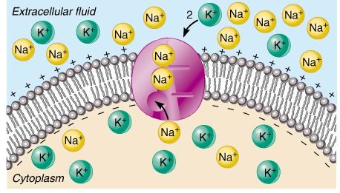
Resting potential
When an axon is not transmitting an impulse it is slightly positive on the inside and very positive on the outside.
In this state, the sodium-potassium pumps actively transport three sodium ions out of the cell for every two potassium ions they pump in to the cell.
When the outside of a neuron is more positive than the inside, this is known as resting potential.

Slide 6
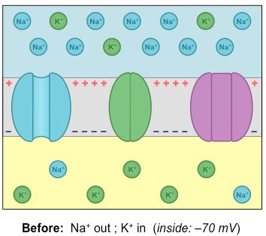
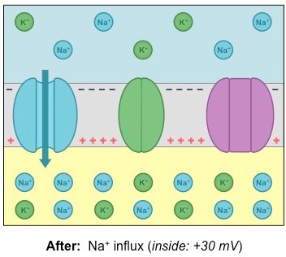



Action potential
When an impulse is triggered, the membrane become more permeable to sodium ions.
The sodium ions that have been actively pumped outside of the cell are about 10 times more concentrated than they are on the inside of the cell, so they diffuse rapidly.
This leads to a large positive charge on the inside of the cell and a small charge on the outside.
The sudden change in membrane potential is called depolarisation and results in action potential.
The small action potential travels like a ripple along an axon.

Slide 7
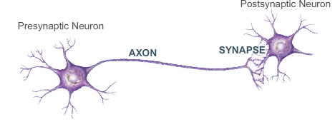
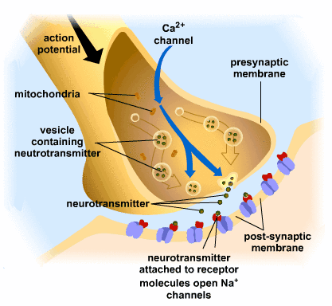
Transmission between neurons
A signal is passed from one neuron to another by converting it from an electrical signal to a chemical signal called neurotransmitters.
Neurotransmitters are stored in vesicles in the presynaptic neuron.
When an impulse arrives at the synapse, it causes calcium ions channel to open causing an influx of calcium ions which stimulates exocytosis of neurotransmitters.
The neurotransmitters bind with receptors of the postsynaptic cell, causing ion channels to open there and trigger an action potential in the target neuron.
Excess neurotransmitters are deactivated by enzymes and recycled back in to the presynaptic cleft in a process called reuptake.

Slide 8
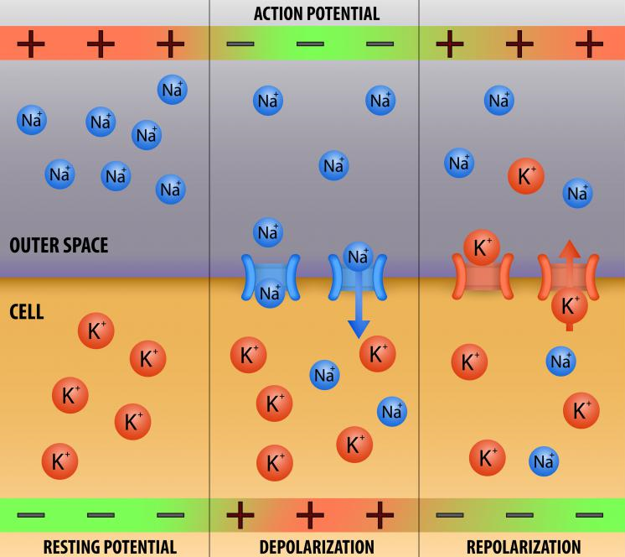
repolarization
Repolarization typically results from the movement of positively charged K⁺ ions out of the cell.
Repolarization is vital because it restores the K⁺ ion concentration in the extracellular space, allowing the sodium potassium pumps to restore resting potential.

Slide 9
Check for understanding
Outline the role of a sodium potassium pump.
Draw a diagram or write a paragraph to summarise how the nervous system works to pass information collected by a receptor to the central nervous system.

Slide 10
Video link
The Nervous System, Part 2 - Action! Potential! By Crash Course - https://www.youtube.com/watch?v=OZG8M_ldA1M

